Slide 1
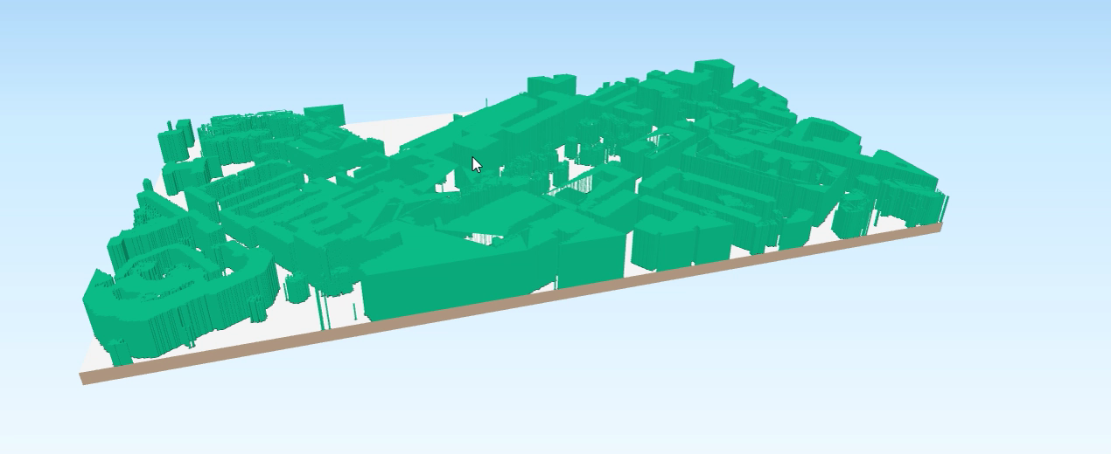
Using DSM and DTM to obtain LOD1:
Read
DSM
DTM
Subtract DSM and DTM
nDSM
nDSM>Threshold
BnDSM
Zonal statistics using BnDSM as mask
LOD1

Slide 2
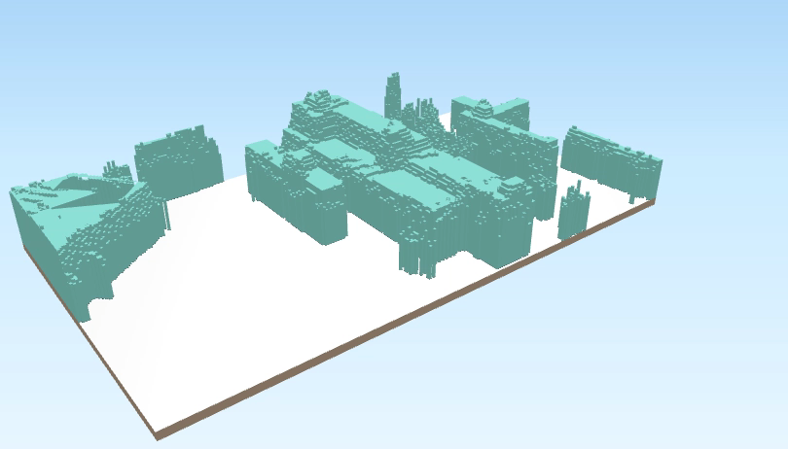
Continued.
Read
DSM
DTM
Subtract DSM and DTM
nDSM
nDSM>Threshold
BnDSM
Polygonize
LOD1

